Slide 1
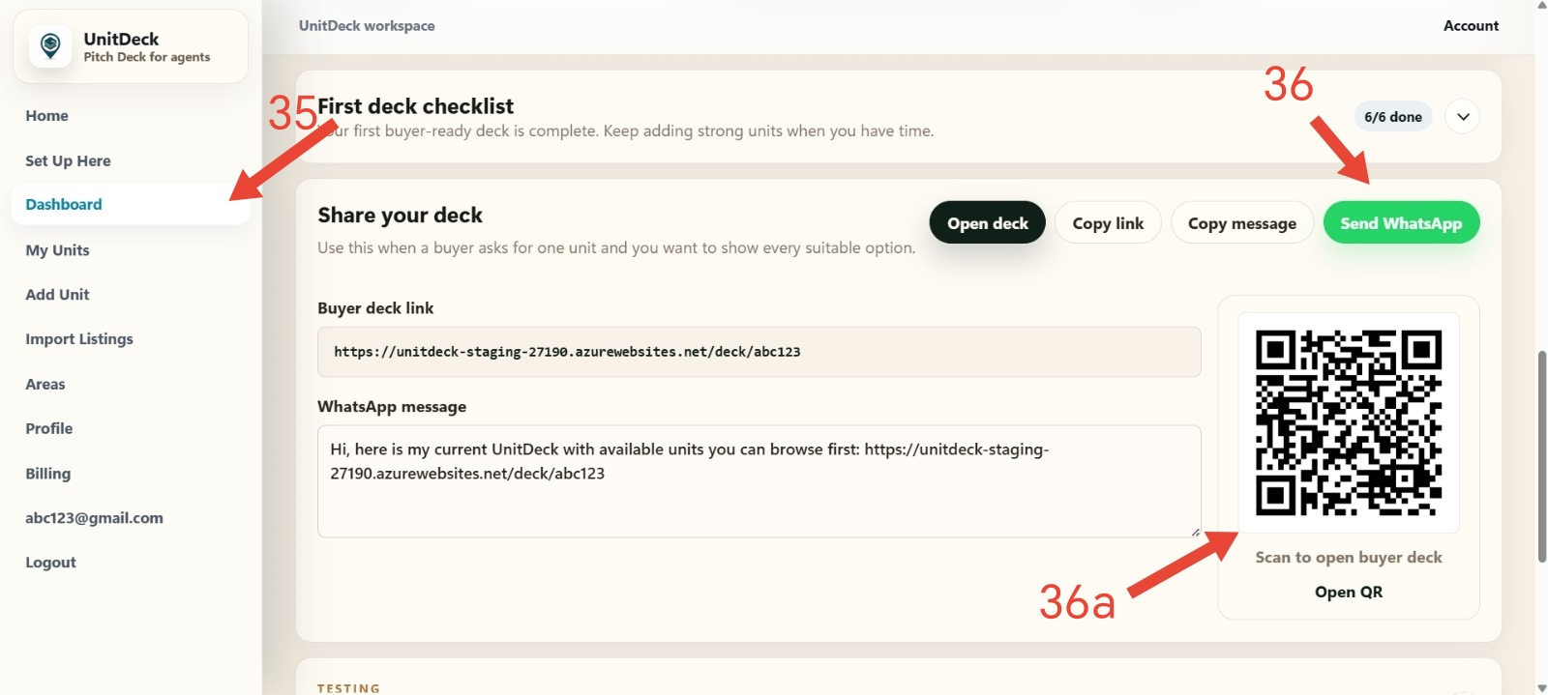
UnitDeck
Agent User Guide
Step 1 to Step 36A
TRAINING GUIDE
UnitDeck Agent
Training Guide
A practical guide from account access to sharing your buyer deck.
WHAT THIS GUIDE COVERS
Account access, profile setup, areas, imports, media sections, unit review
, and buyer deck sharing.
HOW TO USE IT
Follow the red step marks on the screenshots, then read the Goal,
What to do, Tip, and Check before next.
English-first with short Chinese helper notes

Slide 2
UnitDeck
Your UnitDeck setup journey
Workflow overview
OVERVIEW
From first login to a buyer-ready deck.
Complete these five stages to prepare a buyer-ready deck.
1
2
3
4
5
Account
Profile
Areas
Units
Share
Request beta access,
confirm email, and log in
after approval.
Add public identity,
WhatsApp, photos, logo,
and verification.
Create simple
buyer browsing sections
by location.
Import listings,
review drafts,
upload photos,
and organize media.
Open deck, copy link,
send WhatsApp,
or show QR code.
DONE IN ORDER
DONE IN ORDER
DONE IN ORDER
DONE IN ORDER
DONE IN ORDER

Slide 3
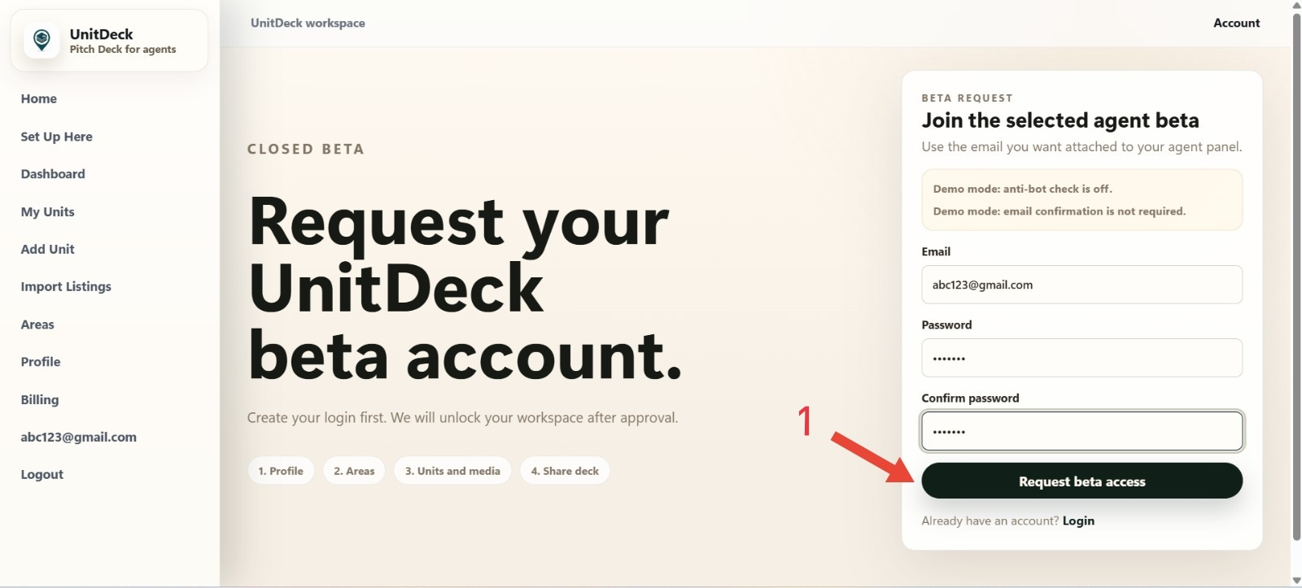
UnitDeck
Step 1 | Request beta access
Account
DO THIS
Enter email and password.
CHECK
After submitting, wait for approval

Slide 4
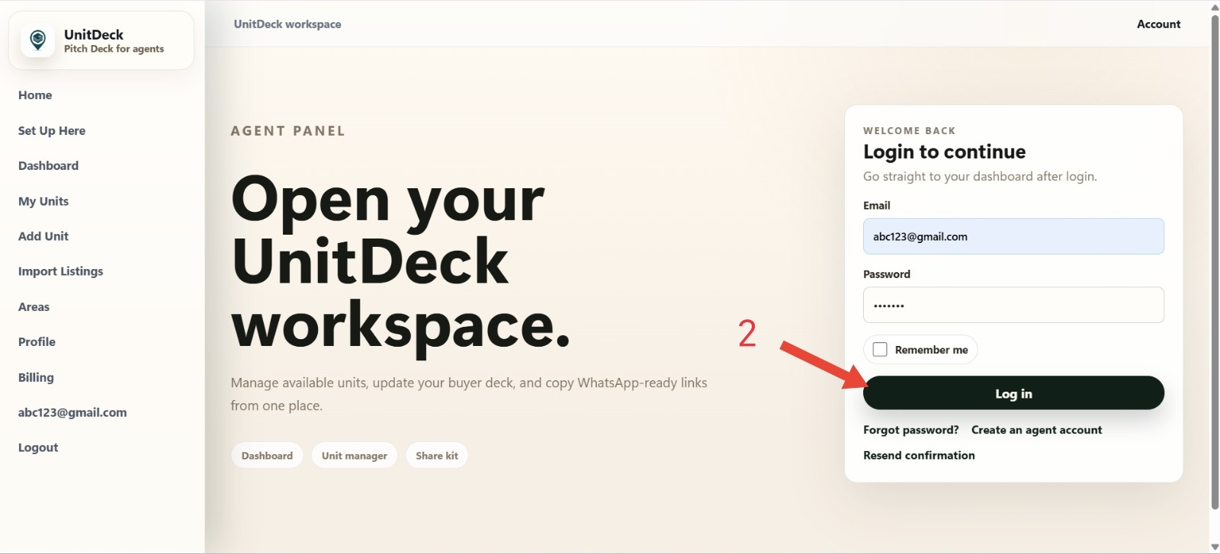
UnitDeck
Step 2 | Log in to workspace
Account
2
DO THIS
Log in after approval.

Slide 5
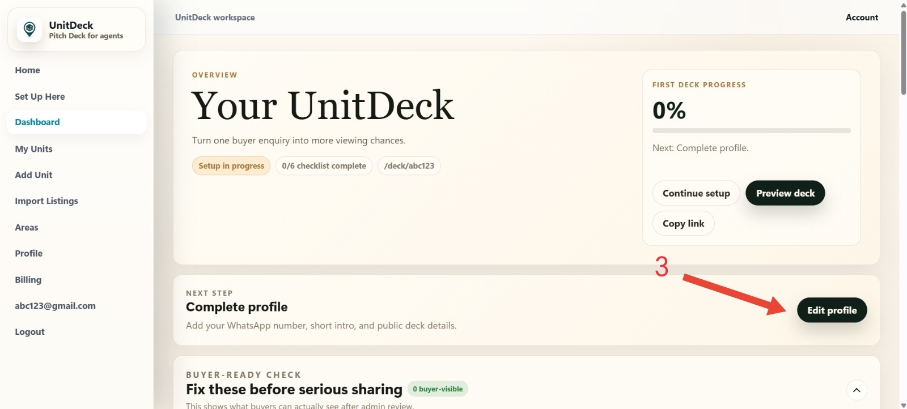
UnitDeck
Step 3 | Open profile setup
Profile
3
DO THIS
Click Edit profile.

Slide 6
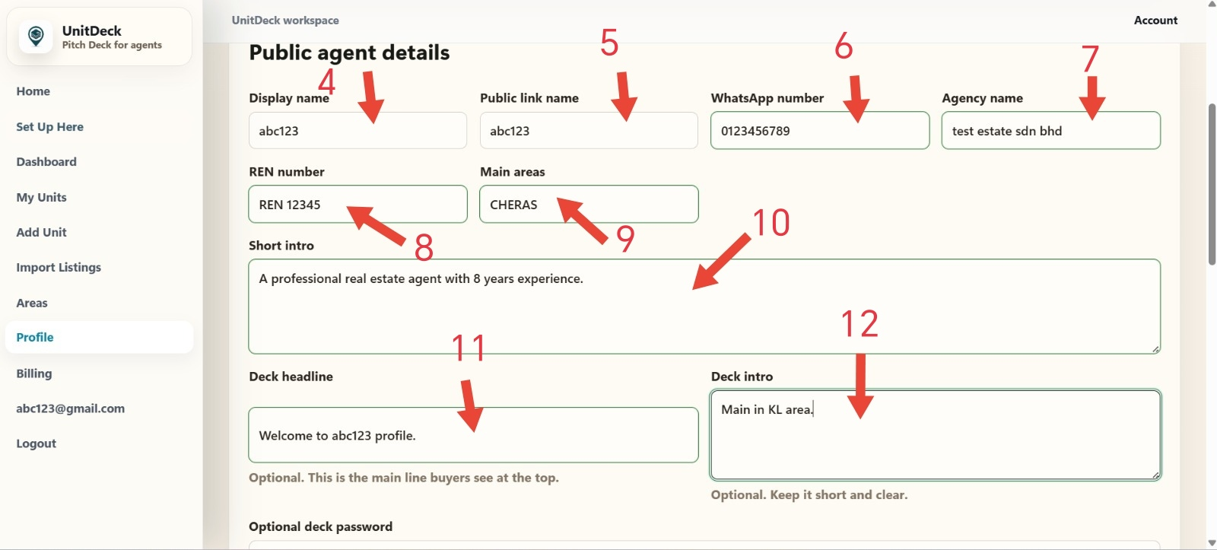
UnitDeck
Steps 4 to 12 | Fill public agent details
Profile
4
DO THIS
Fill public profile fields.

Slide 7
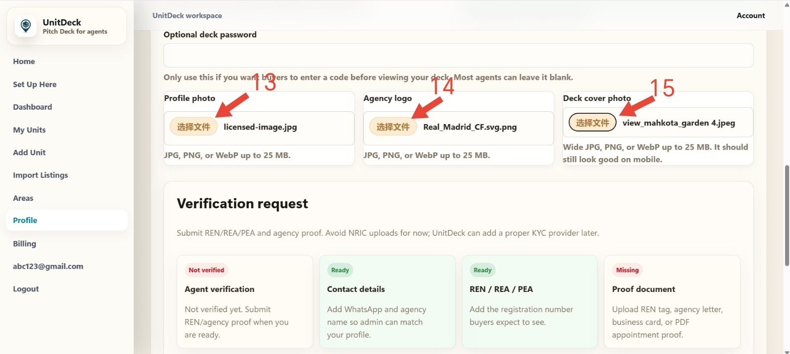
UnitDeck
Steps 13 to 15 | Upload profile images
Profile
5
DO THIS
Upload photo, logo, cover.
Use clear, real images.

Slide 8
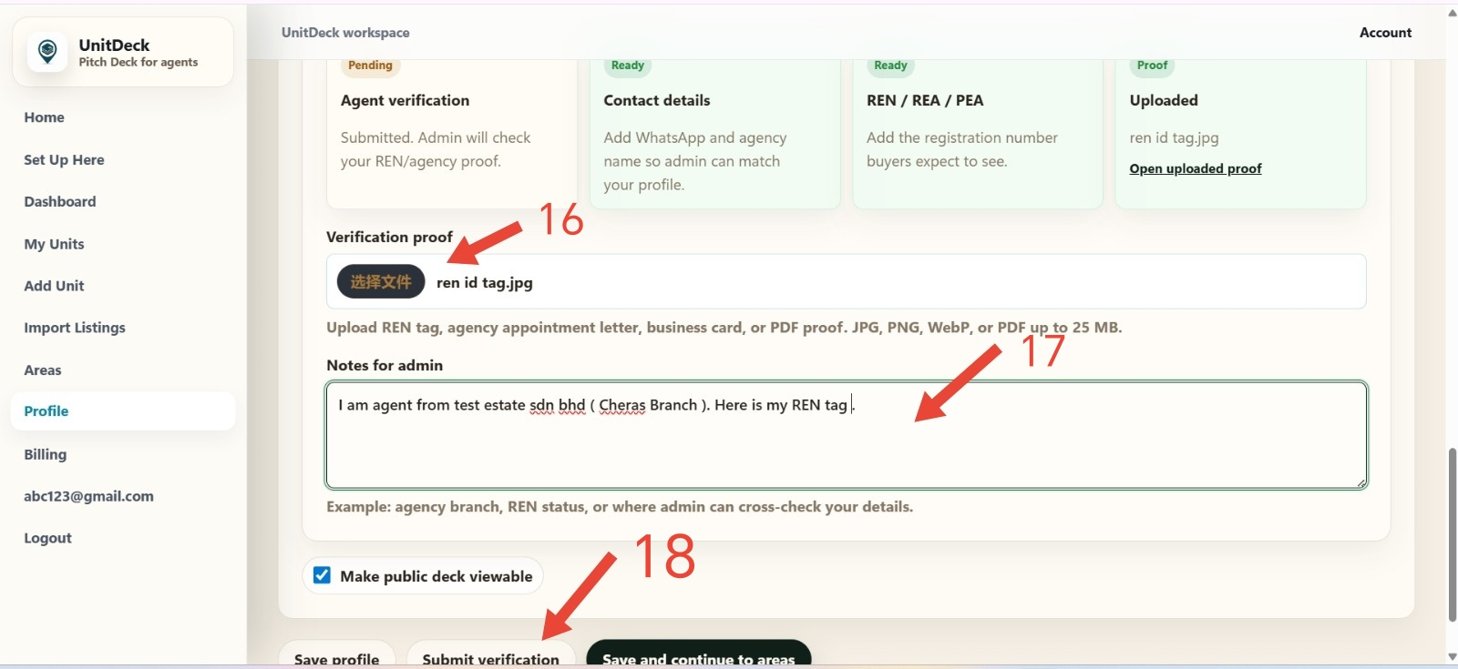
UnitDeck
Steps 16 to 18 | Submit verification
Profile
6
DO THIS
Upload REN proof.
CHECK
Submit and wait for review.

Slide 9
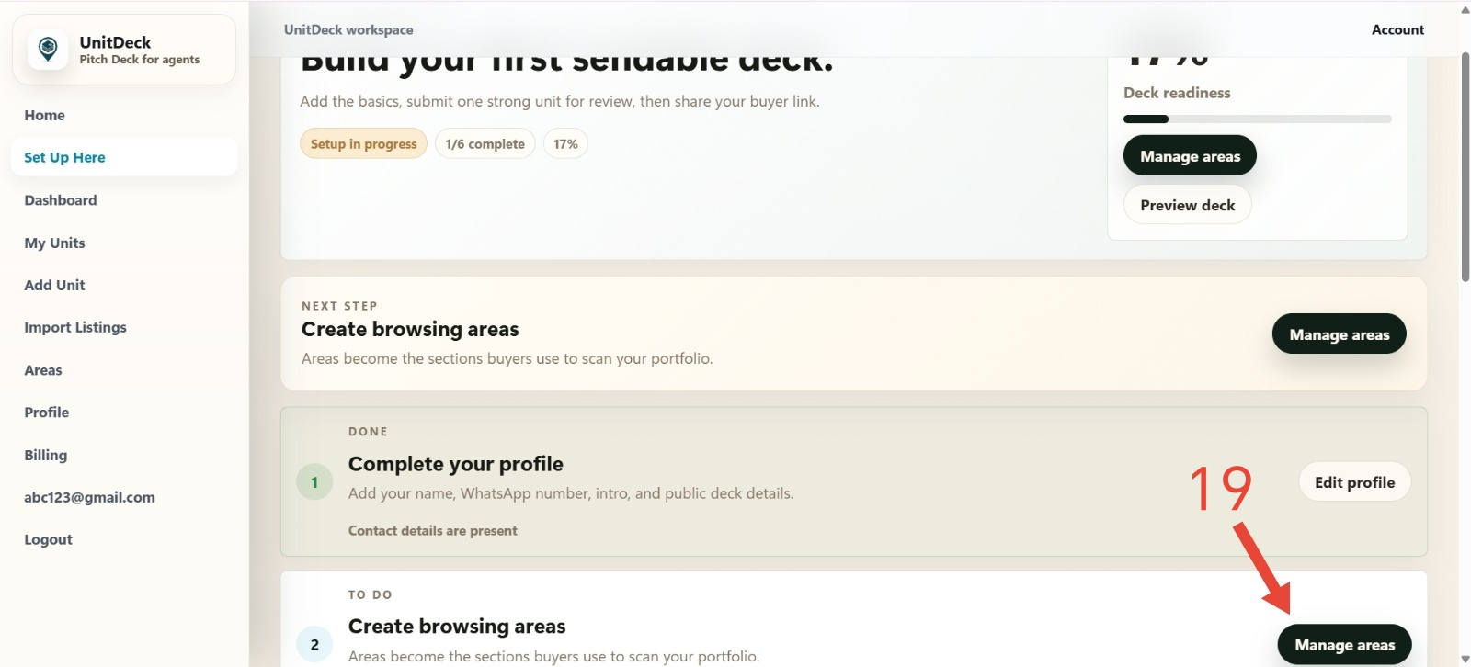
UnitDeck
Step 19 | Manage areas
Areas
DO THIS
Click Manage areas.

Slide 10
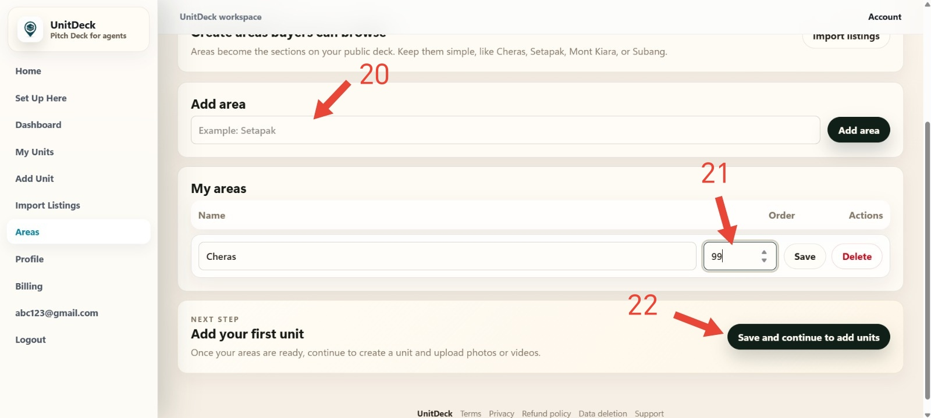
UnitDeck
Steps 20 to 22 | Create areas and continue
Areas
8
DO THIS
Add areas and order.
Avoid duplicate spelling.

Slide 11
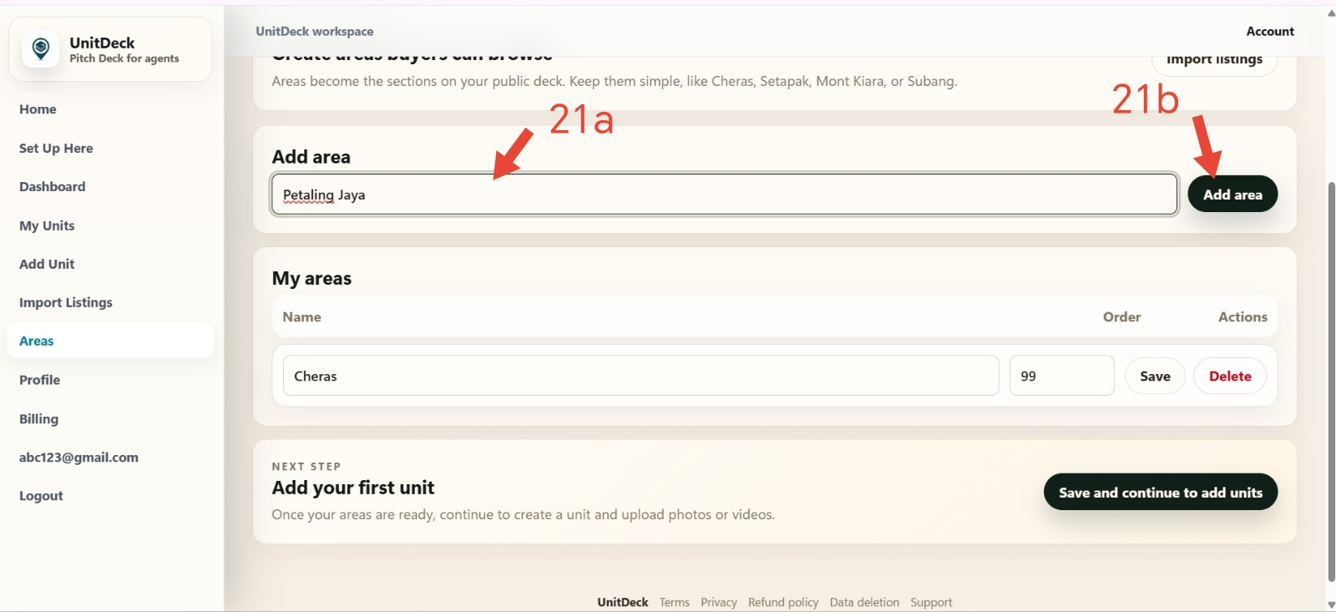
UnitDeck
Steps 21A to 21B | Add a new area
Areas
DO THIS
Type area, click Add.
CHECK
The new area should appear in My areas.

Slide 12
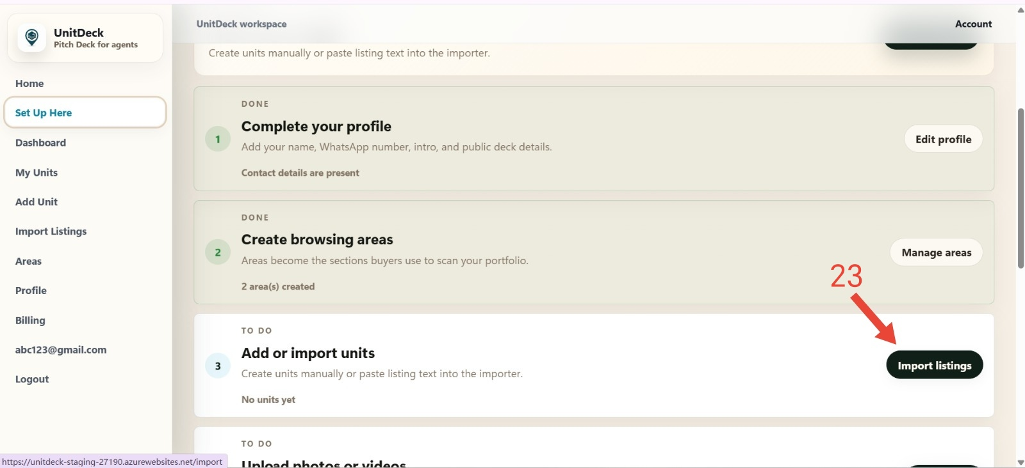
UnitDeck
Step 23 | Open Import Listings
Import
DO THIS
Open Import listings.

Slide 13
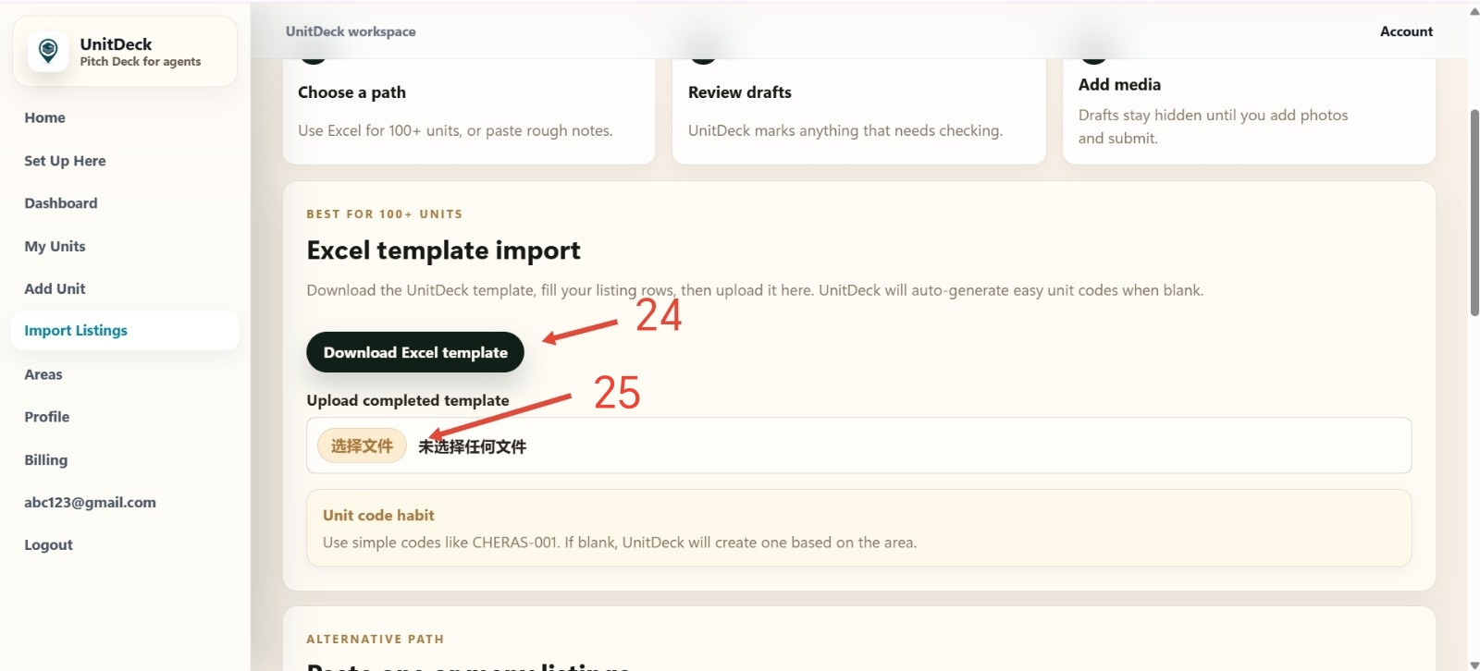
UnitDeck
Steps 24 to 25 | Download and upload template
Import
DO THIS
Download template first.
CHECK
After upload, UnitDeck should show draft.

Slide 14
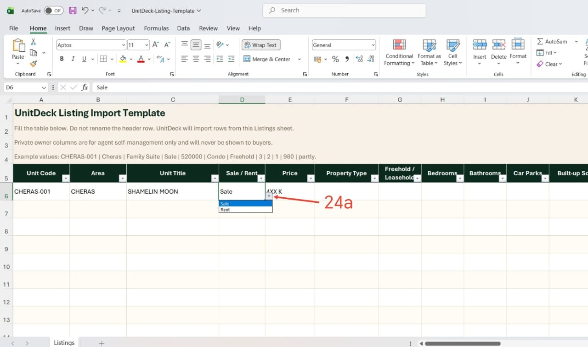
UnitDeck
Step 24A | Fill basic unit details
Excel import
DO THIS
Fill the basic unit row.
CHECK
Area must match UnitDeck.

Slide 15
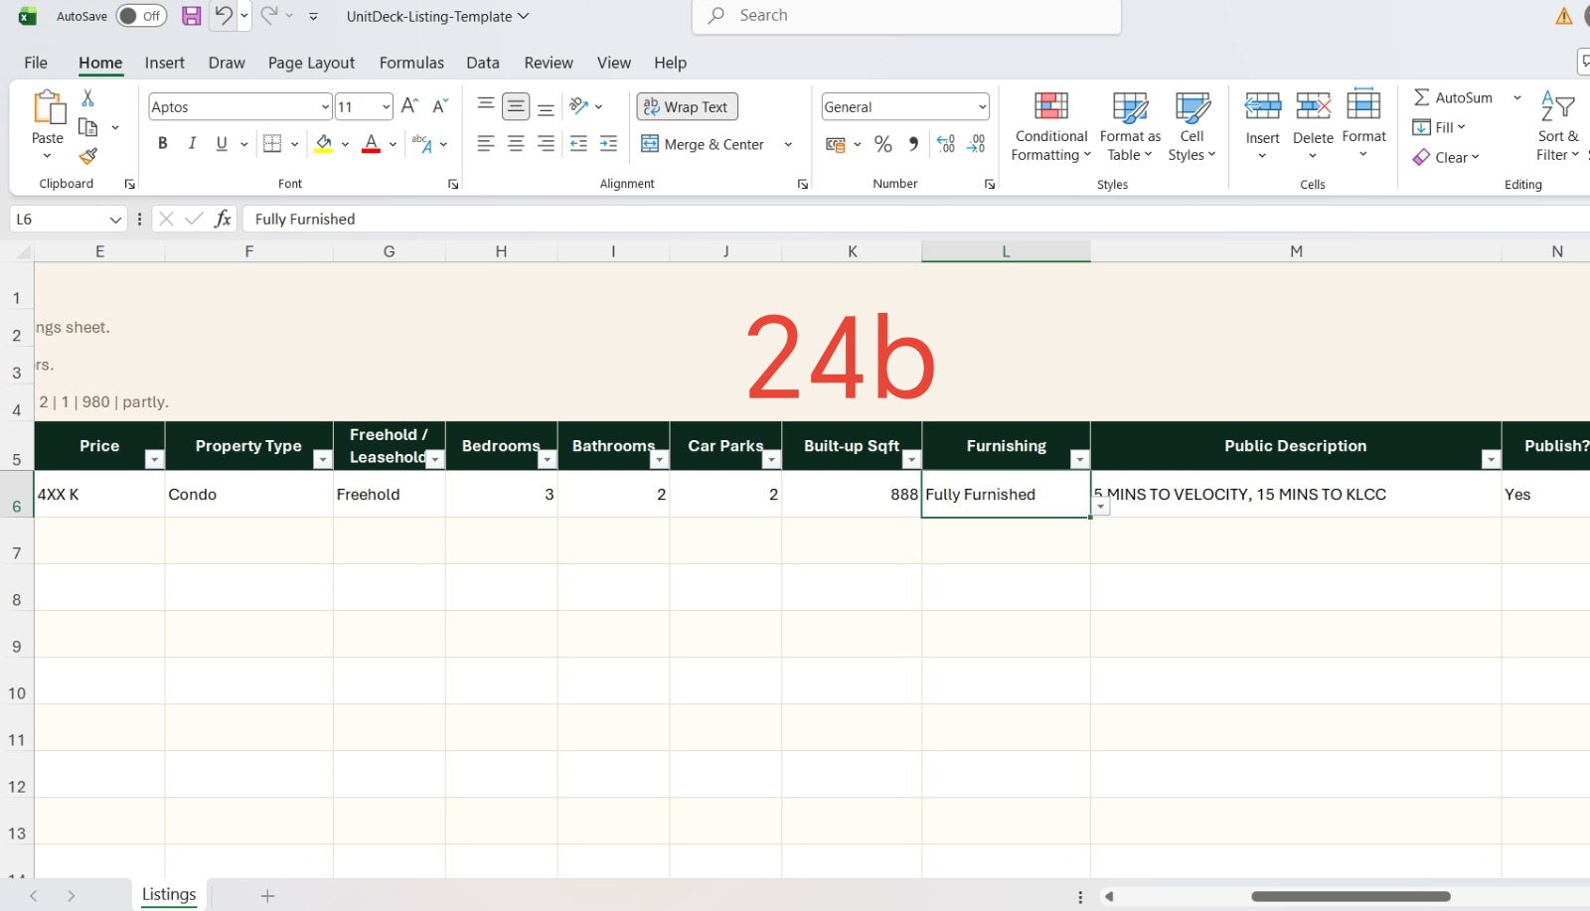
UnitDeck
Step 24B | Fill unit details
Excel import
DO THIS
Fill tenure, rooms, sqft.

Slide 16
UnitDeck
Step 25 | Upload completed Excel
Import
DO THIS
Upload completed Excel.
CHECK
Wait until UnitDeck shows draft units.

Slide 17
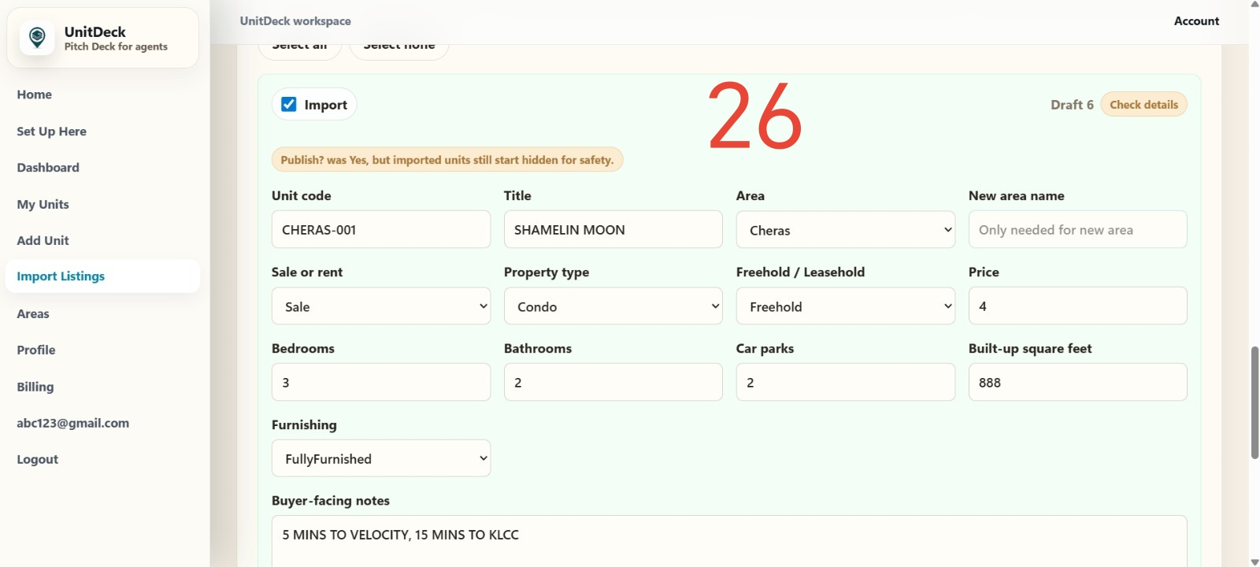
UnitDeck
Step 26 | Review import drafts
Import
DO THIS
Check drafts before import.

Slide 18
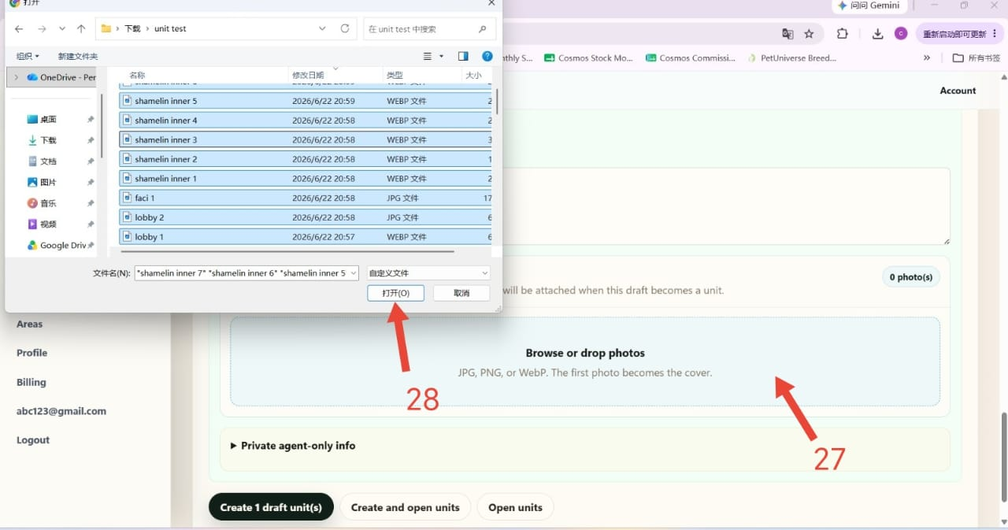
UnitDeck
Steps 27 to 28 | Upload unit photos
Media
DO THIS
Browse or drop photos.
CHECK
Wait for upload to finish.

Slide 19
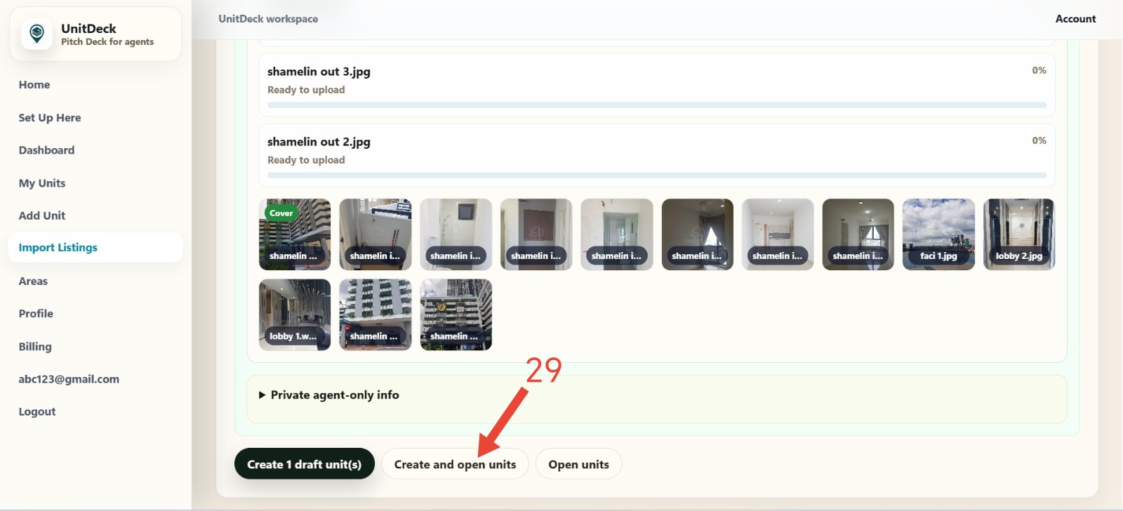
UnitDeck
Step 29 | Create draft units
Import
DO THIS
Create and open draft units.

Slide 20
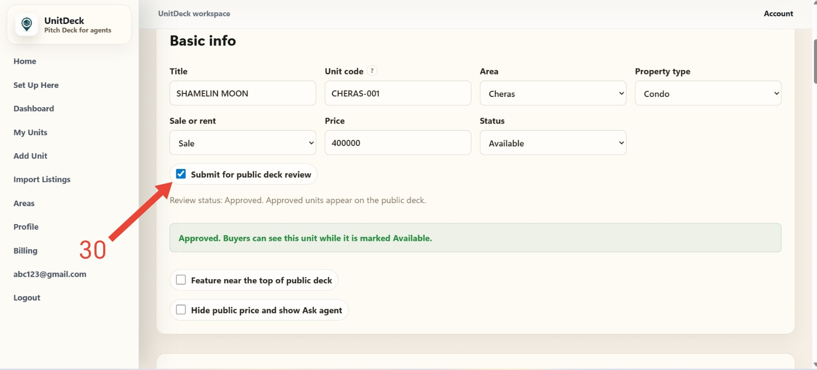
UnitDeck
Step 30 | Submit for public review
Unit review
DO THIS
Tick public deck review.

Slide 21
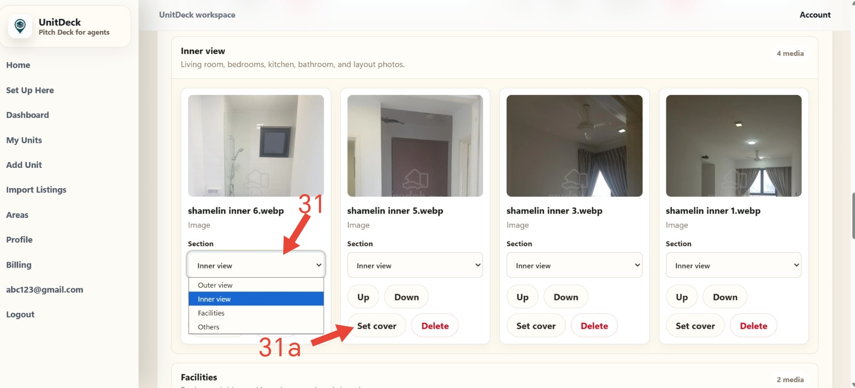
UnitDeck
Steps 31 to 31A | Organize photos and cover
Media
DO THIS
Choose photo section.
CHECK
Set the best cover.

Slide 22
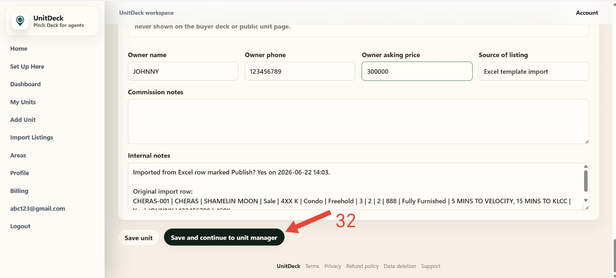
UnitDeck
Step 32 | Save and continue
Unit review
DO THIS
Save and continue.
CHECK
You should return to My Units or the unit.

Slide 23
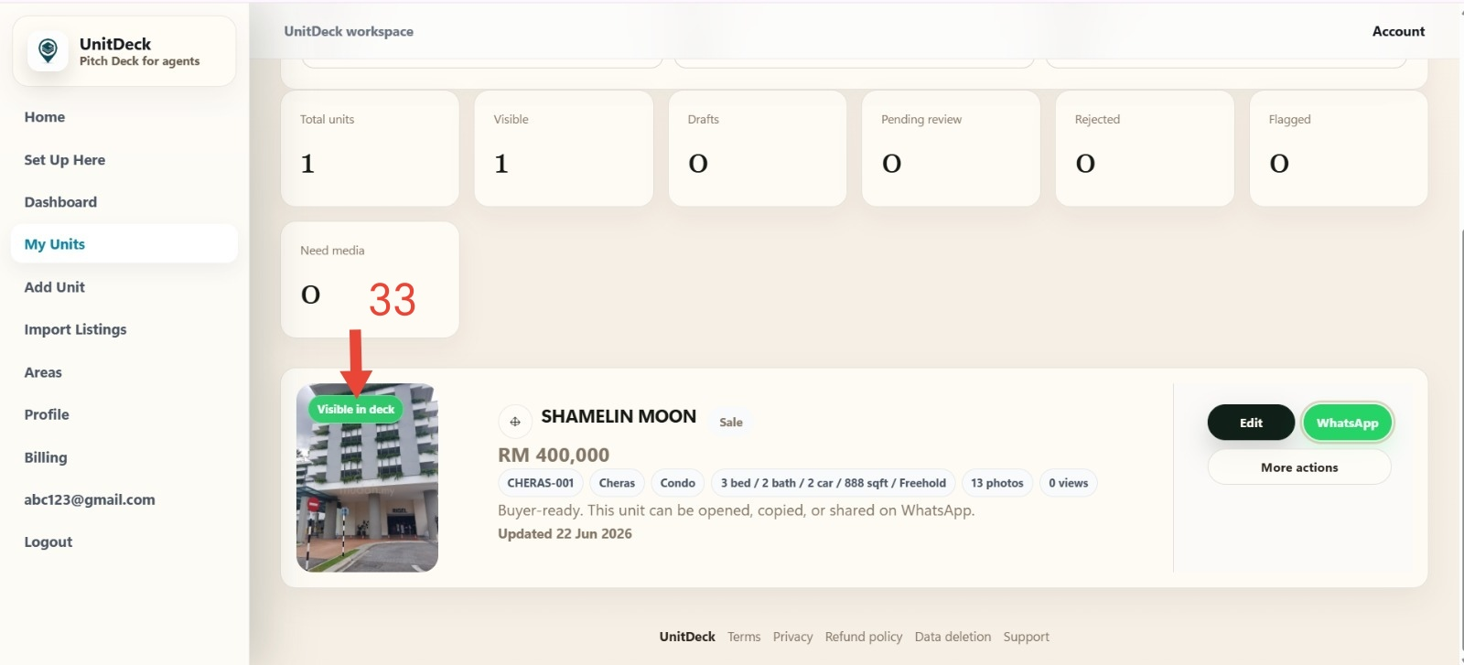
UnitDeck
Step 33 | Check My Units status
My Units
DO THIS
Look for Visible in deck.
CHECK
If the unit is not visible, check review.

Slide 24
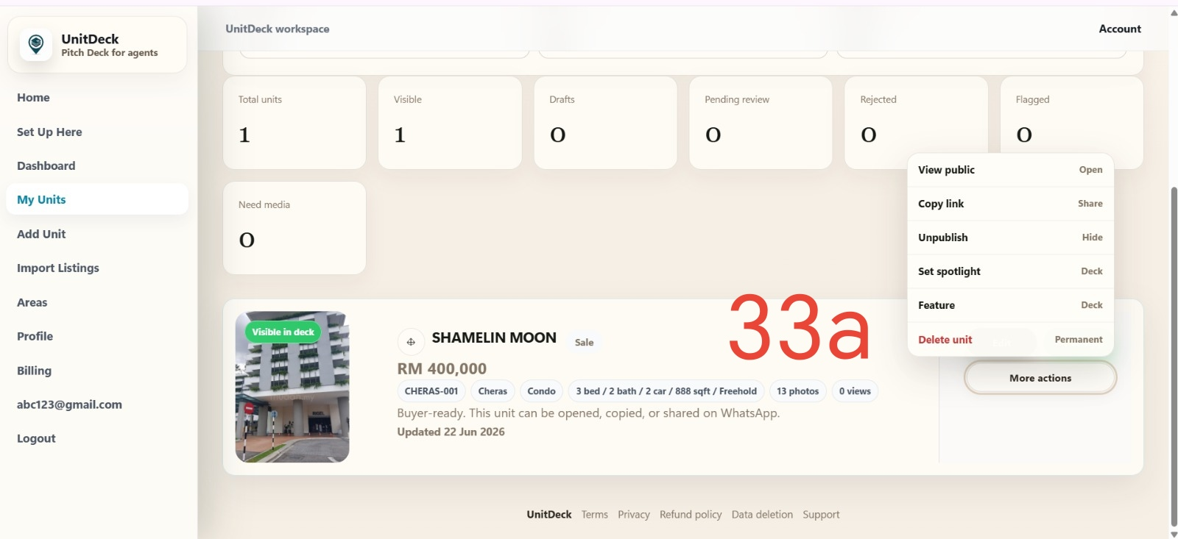
UnitDeck
Step 33A | Use More Actions
My Units
DO THIS
Use More actions if you need to delete or unpublish

Slide 25
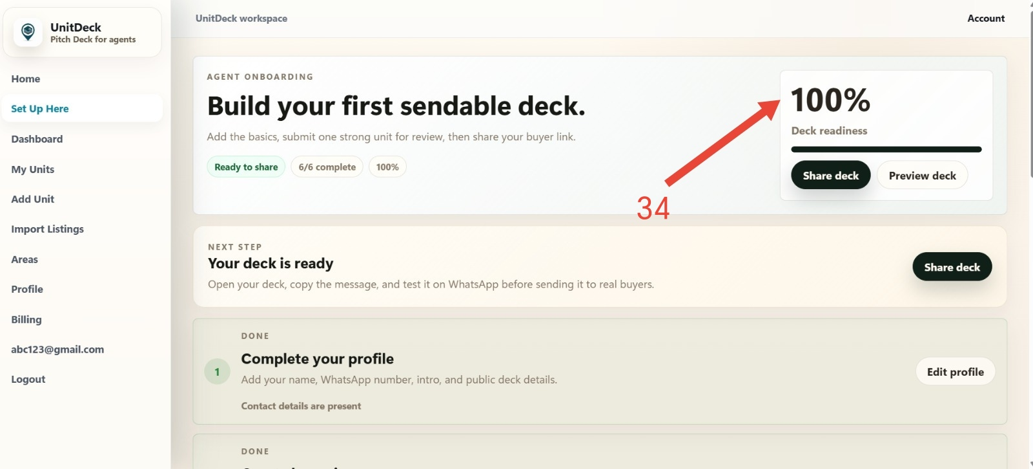
UnitDeck
Step 34 | Confirm deck readiness
Readiness
DO THIS
Check deck readiness.
CHECK
When readiness is complete, share
the deck!

Slide 26
UnitDeck
Steps 35 to 36A | Share the buyer deck
Share
DO THIS
Copy link or WhatsApp.
CHECK
Open once before sending.

